Slide 1
Big Data Programming: Python HUSHHUSH RECRUITER Presentation - 2
Group 1
Aparanna Dash
Dharshan Dhanashekar
Navneeth Krishna Arravind
Terry Poonacha
Vedanth Balakrishna Reddy
Anil Keshav & Ajinkya Patil
SRH Hochschule Heidelberg

Slide 2
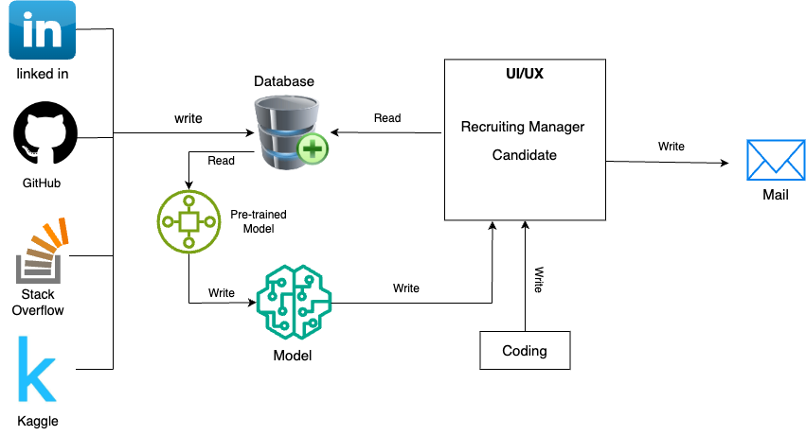
Architecture

Slide 3
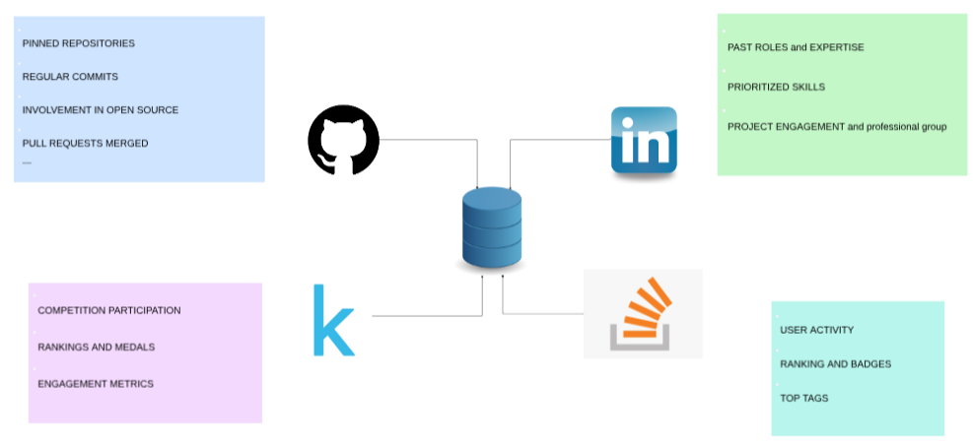
Data Sources

Slide 4
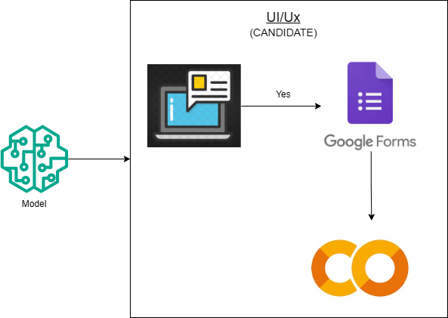
UI/UX Candidate

Slide 5
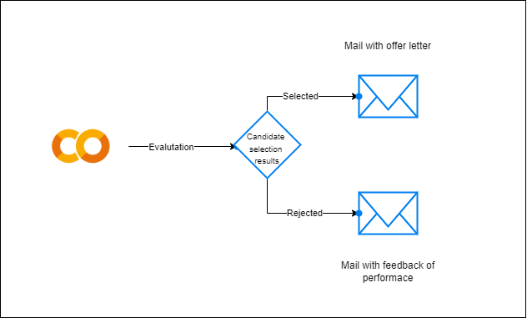
UI/UX Recruiting Manager

Slide 6
Thank You !! ☺

